Slide 1
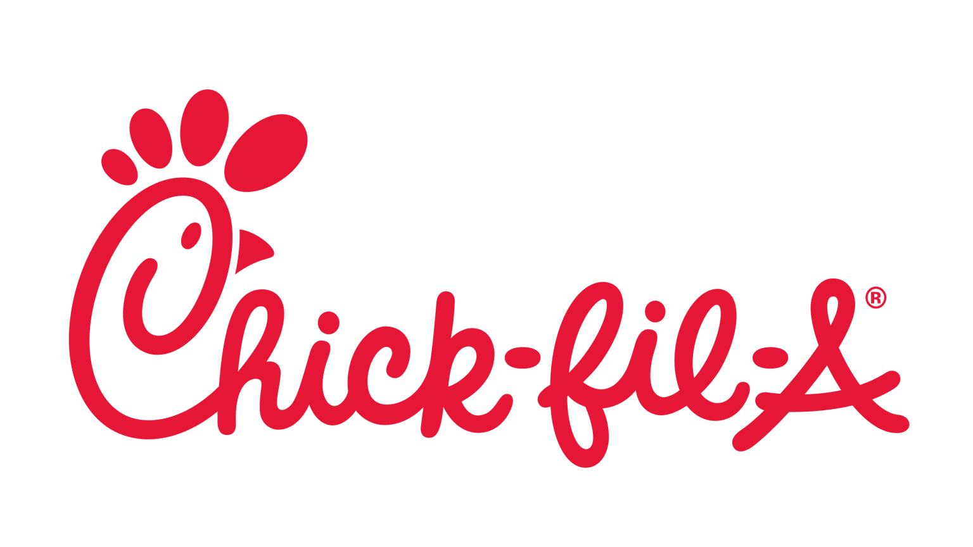


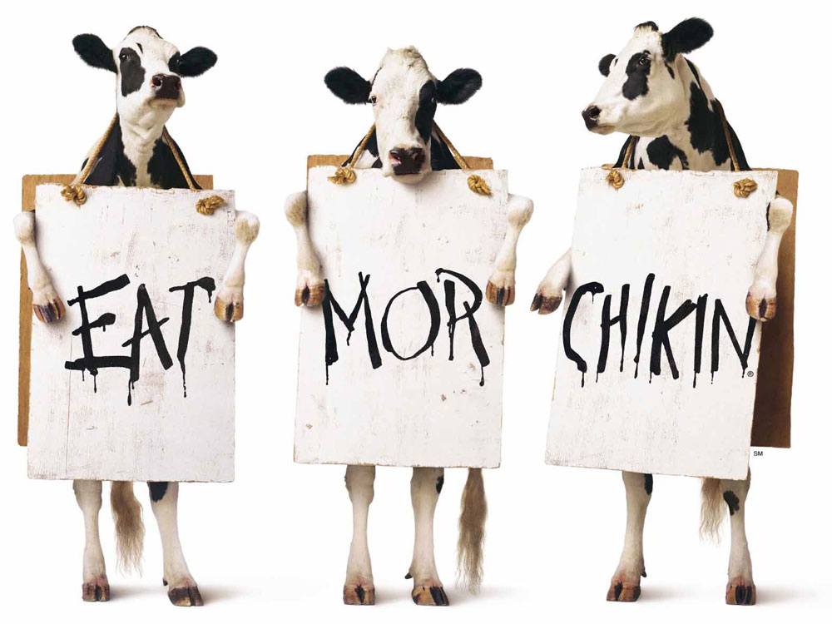
Data Group 5 (MW 12PM)
AISHWARYA BAALAJI RAO
SHREYA VENKATESAN
HANNAH HENRY
SARENNA FONSECA
BRIAN J. CERVANTES ACOSTA

Slide 2
Executive Summary
About: Chick-fil-A is one of the largest fast food chains in the United States. The first restaurant was opened in 1946 in Hapeville, Atlanta and there are now more than 2400 locations across 47 states.
Product: Chick-fil-A is best known for its breaded, boneless chicken sandwich (The Original Chicken Sandwich). The fast food chain also offers a variety of other menu items including breakfast foods, salads, sides, kid’s meals, desserts, and drinks.
Price: Chick-fil-A’s sandwich prices range from $3.05 for a chicken sandwich, up to $6.79 for a spicy chicken sandwich deluxe combo.
Business growth opportunity: Chick-fil-A can steal market share from competing fast food chains such as Wendy’s, McDonald’s, and Burger King through strategic advertising and promotion offerings. Through a 4 Ps and PESTEL analysis, we will determine the most profitable customer to serve along with the most promising region for international expansion.

Slide 3
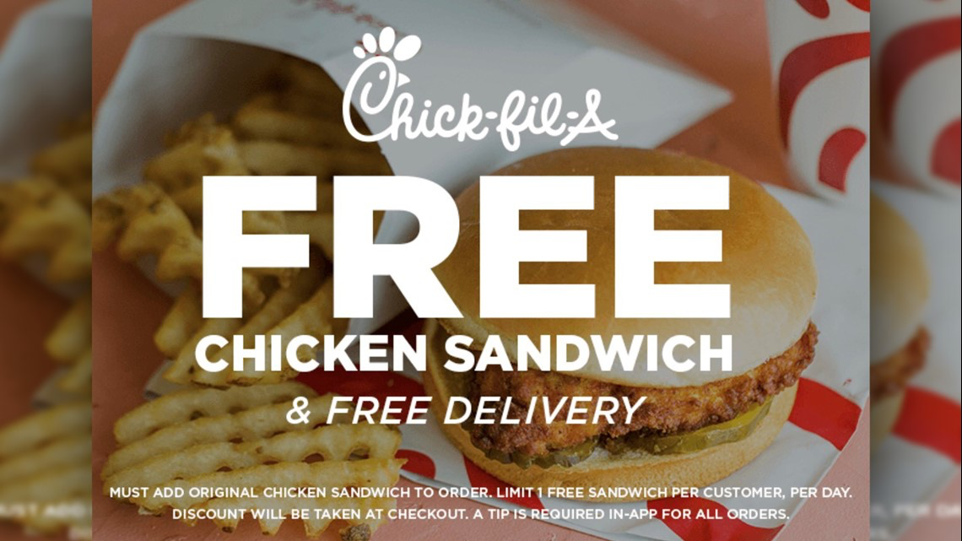
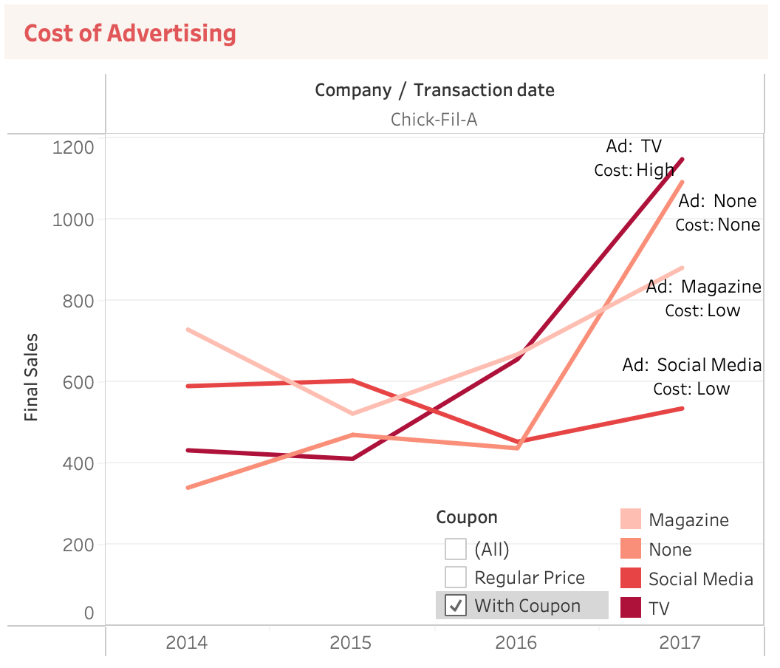
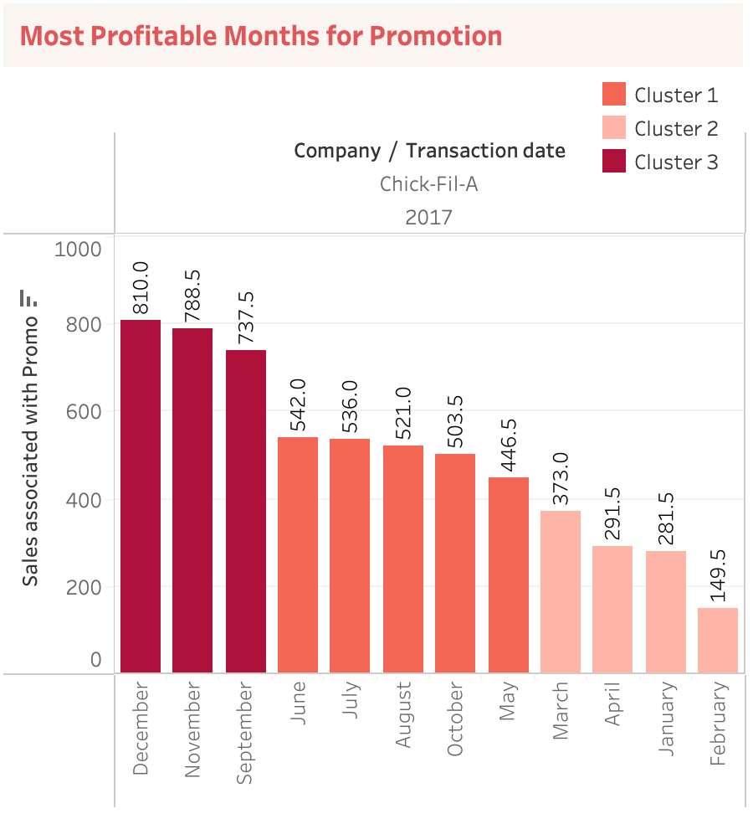
Promotion
Chick-Fil-A is spending heavily on TV advertising for coupon sales.
Engage with customers creatively through low cost channels by offering promos to boost revenue and sales.
Most profitable months for promotions are December, November and September based on the latest past year data.

Slide 4
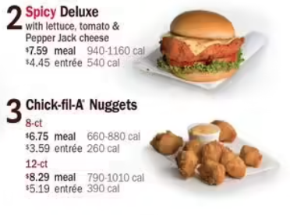
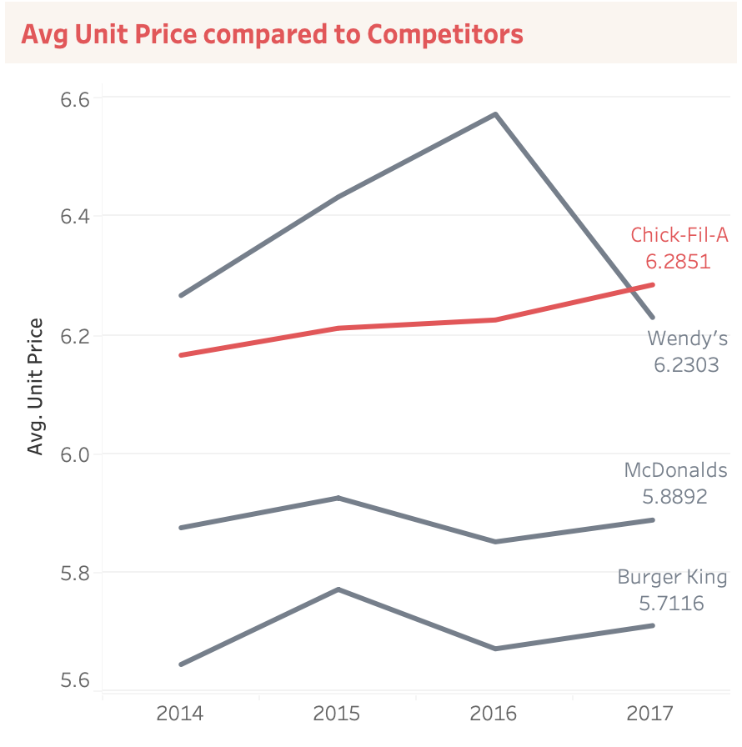
Price
Average unit price for Chick-fil-A is the highest in latest year data compared to competitors.
This rise in cost may be due to increase in cost of ingredients for Chick-fil-A as well as high cost of spending for advertising through TV promotions as mentioned earlier.
Even Wendy’s, our bottom competitor, have managed to bring down their cost significantly from 2016, marketers might have to look for alternative promotion platforms to creatively engage customers and reduce unit price.
Bringing unit price down would increase customer portfolio.

Slide 5
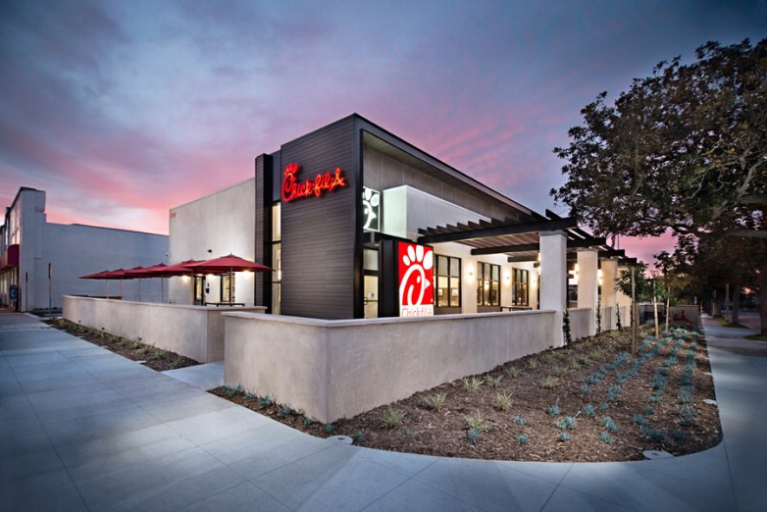
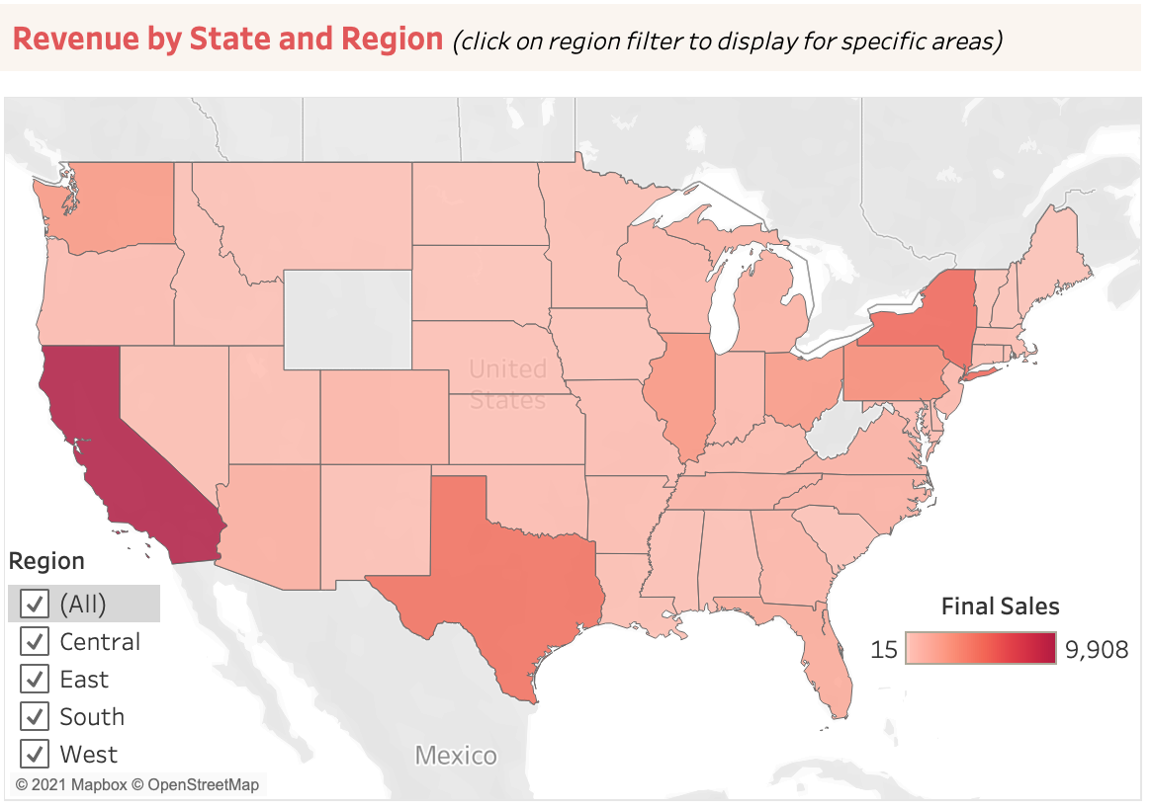

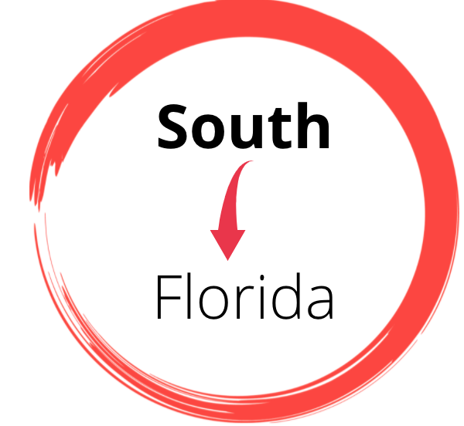

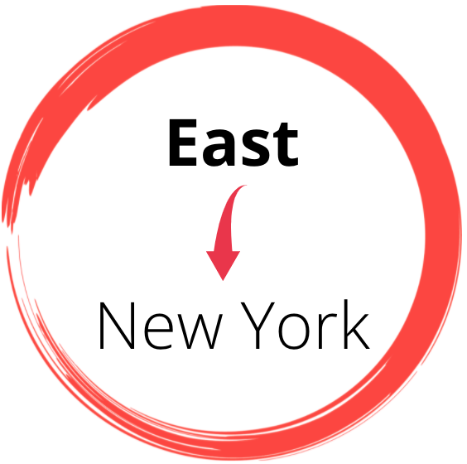
Place
Internal focus should be for moving to Wyoming as that is the largest state in US that Chick-fil-A has not grabbed market share.
Highest amount of final sales were observed in the states below in different regions --
Potential entry

Slide 6
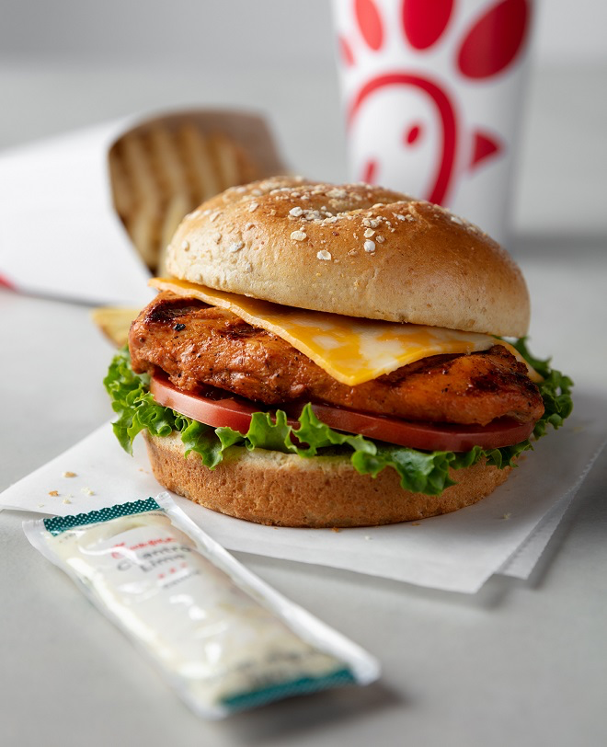
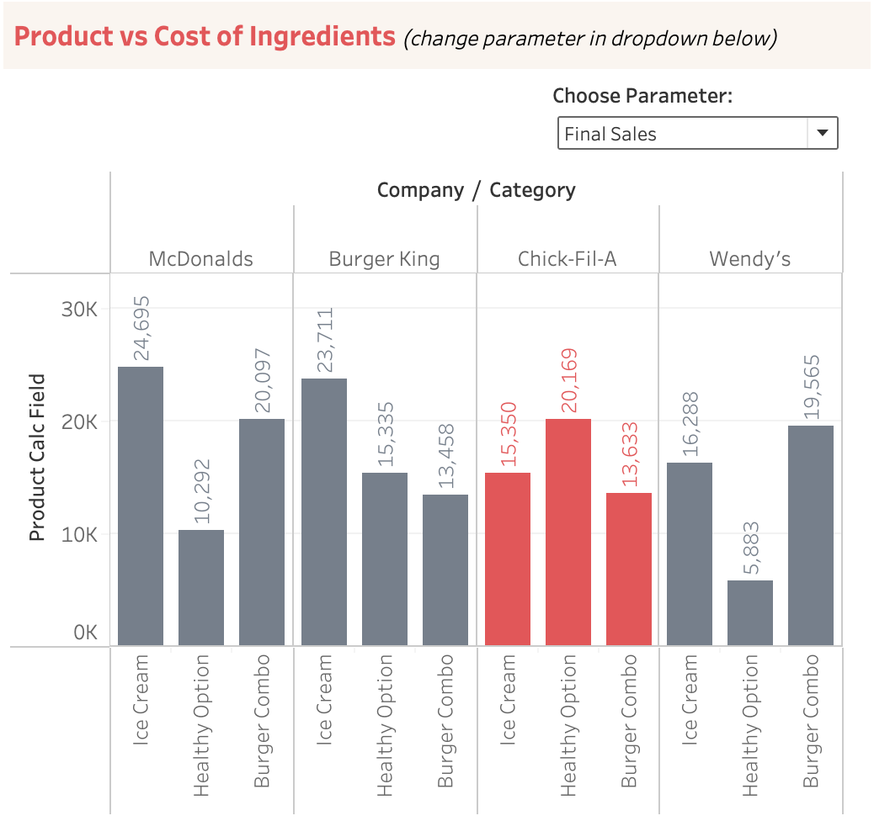
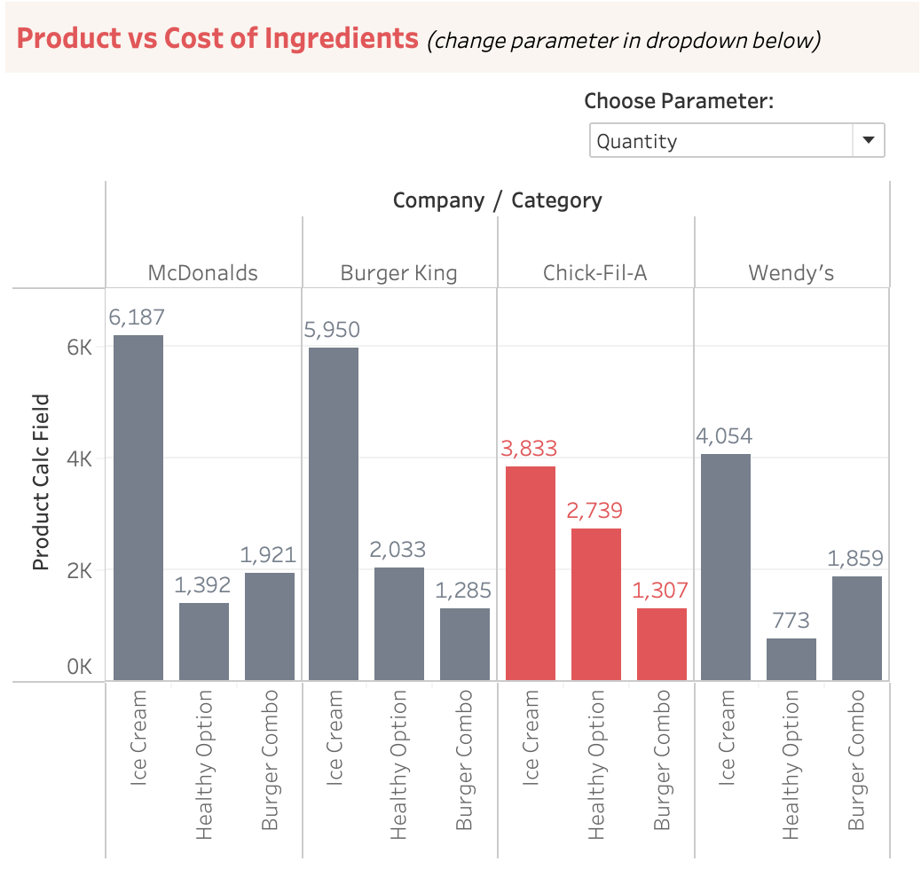
Product
Comparing the final sales (on left) and quantity (on right) based on product category, it is evident that Chick-fil-A needs to promote their ice cream category better in order to increase client portfolio and revenue streams.
We are far behind on sales from ice cream, a major category, even compared to Wendy’s who is a lesser competitor of the 3.

Slide 7

4 Ps Implications
What does this mean for marketers at Chick-fil-A?
Promotion:
Creatively engage with customers on low cost advertising platforms like social media, email marketing and magazines by offering more coupons on these platforms when they subscribe or follow especially in the months of December, November and September.
Price:
By bringing promotion costs low, we could potentially decrease the average unit price of products competitively and increase customer portfolio.
Place:
Focus marketing efforts in states with highest sales -- California, Florida, Texas and New York. Look into opening stores in Wyoming in order to gain more internal market share.
Product:
Increase promotions for ice cream products since customers are consuming this product in large quantities that is probably being offered better by our competitors.

Slide 8
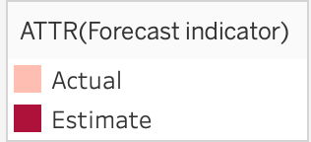
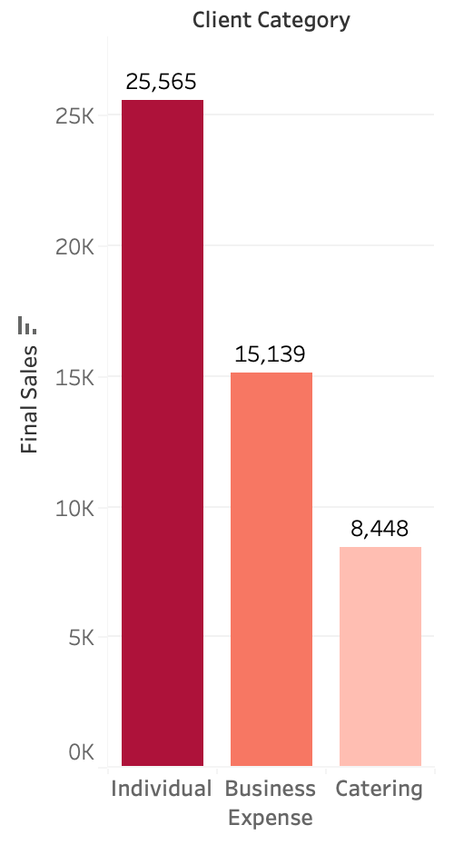
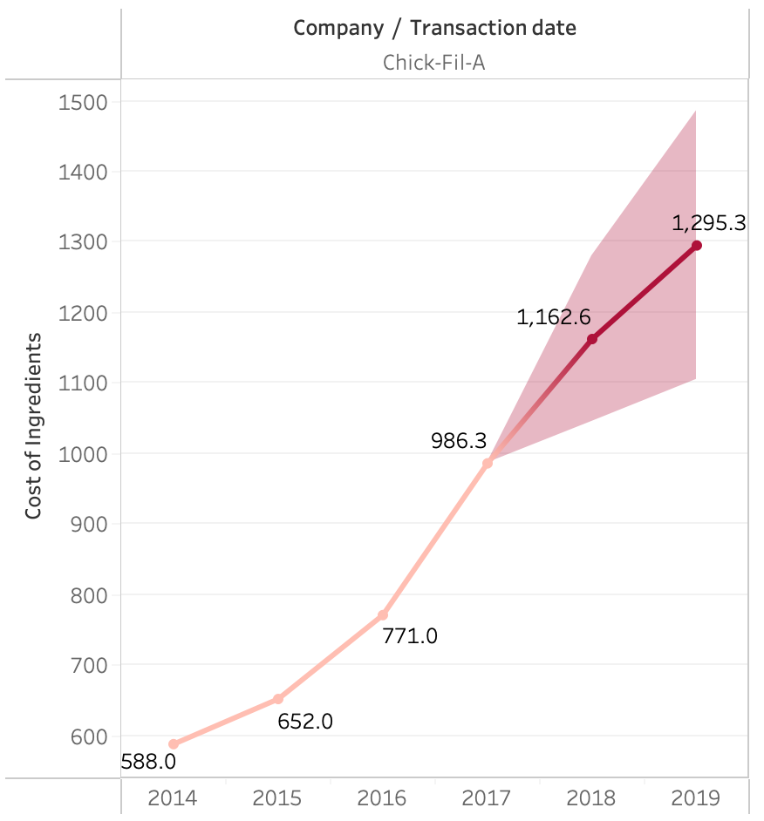
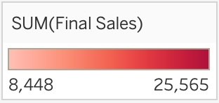
Hypothesis #1 - Most profitable customer to serve
Out of Chick-fil-A’s client categories the most profitable customer to serve will be individual customers (working class people living in the suburban areas that include families and children).
Highest populated states(California, Florida and Texas) are bringing in majority of sales, including New York.
Chick-fil-A’s competitive advantage is based on high end quality chicken that serves as quick as fast food restaurants. Profitable customers will be people who are willing to pay a little extra for a high-caliber chicken based meal.
Since Chick-fil-A’s healthy combo is the highest selling category on the menu, the most profitable customer to serve would be health conscious people.

Slide 9

Internal Value
My Pleasure!
Chick-Fil-A will provide an Experiential Value to its customers
Branding
help people to quickly identify their products and organization.
Known as a company with phenomenal customer service
Design
Red and White colors with a logo of chicken
Three cows with a sign saying “Eat more Chicken”
Customer Experience
focused on human interaction
“My pleasure”
Always greet with a smile
Customer Service
is the sum of the entire customer journey
Providing the customer with drive through, dine in, and delivery 6 days out of the week

Slide 10

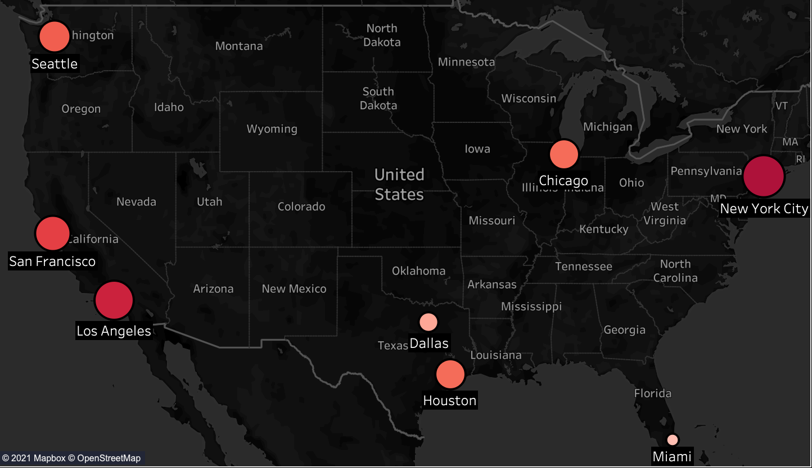
Hypothesis #2 - Sydney, Australia
Australia is the most promising for international expansion because it is in the top 5 countries that consume chicken which will make us believe they will enjoy our boneless chicken sandwich (The Original Chicken Sandwich) and any other option from our menu.
Sydney is the most promising city because Chick-Fil-A is most profitable in large cities like NY, CA, and TX. Sydney is the largest city in Australia with a total population reported in 2020 of 5.7 million resident.
The language most widely spoken in Sydney is English, followed by Vietnamese, Arabic, Cantonese, Mandarin and Greek so there will be no language barrier.
Price is the easiest factor to manipulate in an international setting and can be adjusted to Sydney’s cost of living.

Slide 11

Political
Anti Corruption and Bribery
This helps to improve Australia's investment opportunities overseas and is an important aspect of Australia's global reputation.
Free trade agreements
Australia has six Free Trade Agreements (FTAs) with other countries in force and another eight under negotiation.
Australia-United States FTA
In 2019-20, the United States was our second-largest two-way trading partner in goods and services, worth $80.8 billion
Implications for Chick-Fil-A
Will benefit from the anti corruption laws and the free trade agreement with the U.S. which will reduce or eliminate certain barriers to trade in goods and services, as well as investment.

Slide 12

Legal
Health & Safety Law
Under Australian WHS laws the business must ensure the health and
safety of their workers and not put the health and safety of other people at risk.
National Employment Law
The National Employment Standards (NES) are a set of 11 minimum entitlements which must be provided to all national workplace system employees in Australia.
The Fair Work Act 2009 is arguably the most important piece of employment law in Australia.
It provides the minimum terms and conditions for the majority of employees in Australia that are covered by the national workplace relations system.
Implications for Chick-Fil-A
Chick-Fil-A will have an obligation to comply with all aspects of the Health, Safety and National employment law to ensure employees can work comfortably in a safe and secure environment.

Slide 13
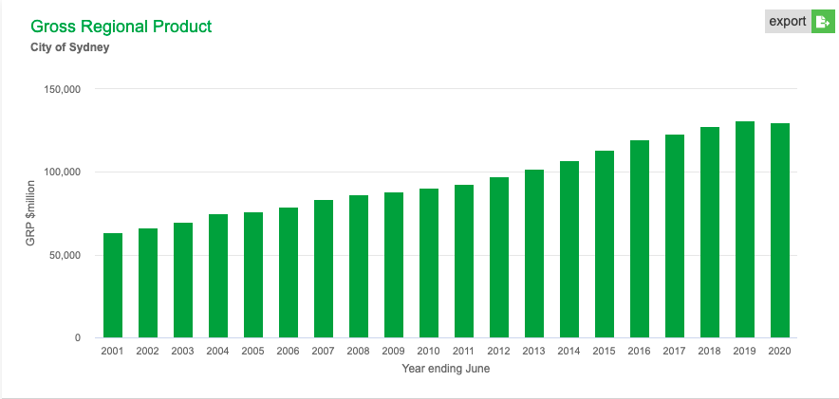
Economic
12th largest economy in the world.
It was relatively less affected by global lockdowns in 2020 and its GDP is expected to grow by 3.1% by 2022.
All companies in Australia are subject to a federal tax rate of 30% on their taxable income.
Company with a turnover of less than $25 million, they qualify for the lower tax bracket.
pay a reduced tax rate of 26% (expected to go down to 25%).
The currency exchange rate favors outside countries, including America, which makes investing into Australian soil and businesses an easy choice.
Implications for Chick-Fil-A
Australia is a great economic target for Chick-fil-a to expand in being in the top 15 economies in the world. Although it does have a significantly high tax rate for companies conducting business there. Compared to the US it shouldn't be a huge burden as businesses have to pay federal tax of about 21% and state tax on top of that.

Slide 14

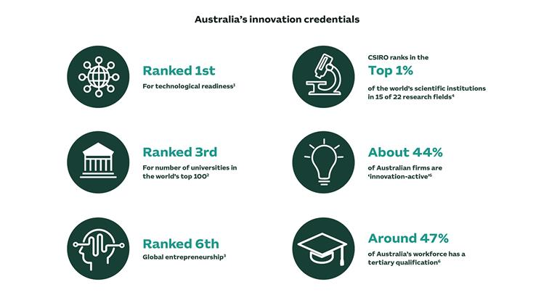
Technological
Australians are technology early adopters and heavy users — a trend accentuated by the COVID pandemic. They managed restaurants quite successfully during the epidemic with the use of QR technology, set menus, and sittings.
The federal government is investing $1.2 billion in drone technologies and artificial intelligence. While brilliant, this should include establishing scientific and engineering capabilities that support the whole digital economy by new emerging technologies or jobs, not just specific technologies.
Australia is lagging behind the US, UK, France, Canada, and China in terms of global competitiveness due to lack of technology incorporation. Only 7.4% of its GDP is ascribed to digital innovation.
Enhancing research-industry links can help create new tech enterprises and assist current ones by elevating emerging digital technologies as a national scientific priority.
Implications for Chick-fil-A
Australia is still one of the fastest technologically growing countries in the world and restaurants may make huge gains if they use the right technology despite lack of digital innovation. Chick-fil-A can use the AI and QR technologies the government is investing in to engage with customers better.

Slide 15
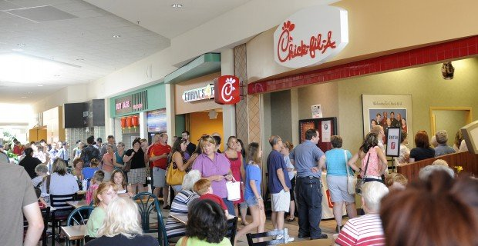
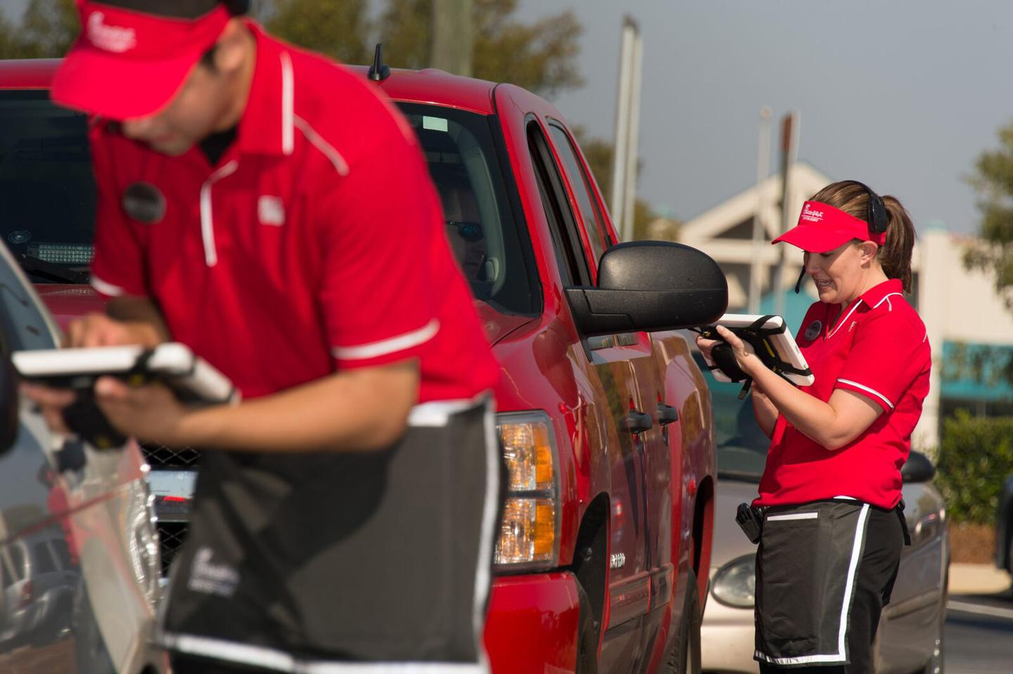
Social
Chick-fil-A meets the fast paced lifestyle of urban customers
like that of New York and cities in California (current top markets).
They have created a quicker and new way to serve their
customers, by using iPads to take orders. They call it “upstream ordering”.
Customers can find Chick fil a in malls, airports, college campuses
and many busy streets connecting neighbourhoods.
Implications for Chick-Fil-A
Sydney is Australia’s largest city and financial hub and using
upstream ordering to serve customers would definitely speed up
orders in this bustling city.
If Chick-fil-A expanded to Sydney, it can also open up restaurants
in such areas such as malls and airports where customers
would get cheap and quick food.

Slide 16

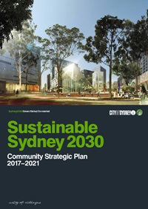
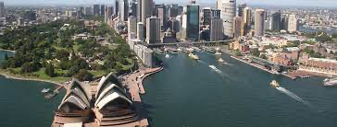
Environmental
Known for its great biodiversity across beaches, mountains, and forests
Driest inhabited continent in the world.
This poses environmental risk factors associated with climate change such as water insecurity, spread of infectious diseases, and conflicts over food, water, and land scarcity.
Sustainable Sydney 2030
Environmental action plan to reduce carbon emissions, and water, energy, and waste demands.
Implications for Chick-fil-A
Chick-fil-A has a goal of influencing the fast-food industry by becoming a leader in sustainability, specifically in the areas of restaurant construction and waste reduction. By expanding internationally into Sydney, Chick-fil-A can continue its sustainable restaurant construction and design while aligning with Sustainable Sydney 2030. However, Australia’s bushfires can cause major damage to businesses, forcing them to close their doors due to smoke issues.

Slide 17

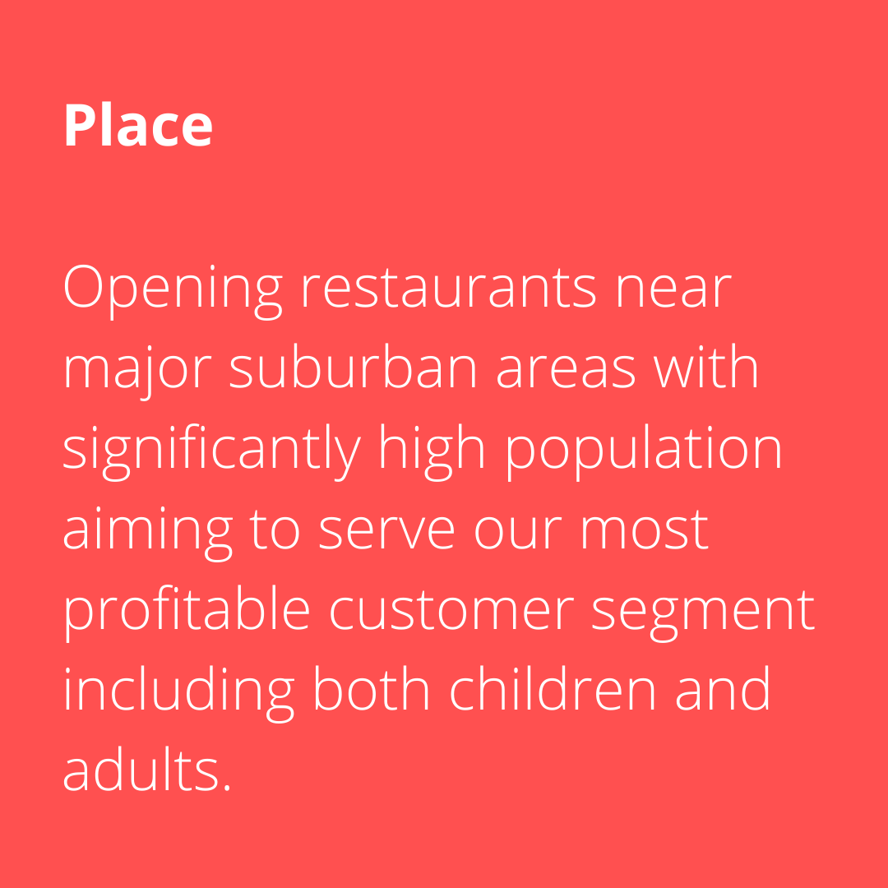
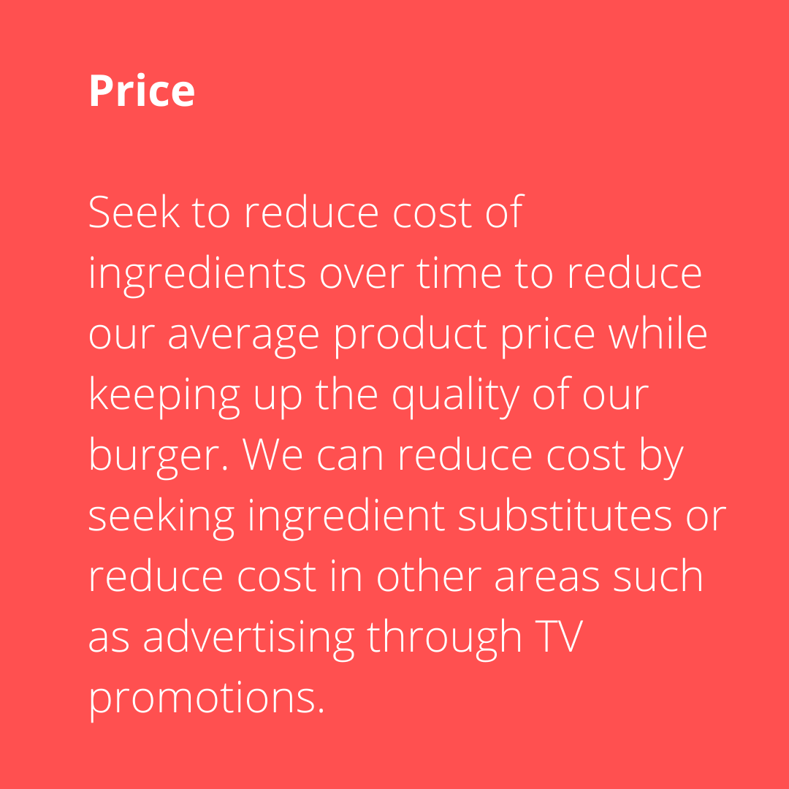
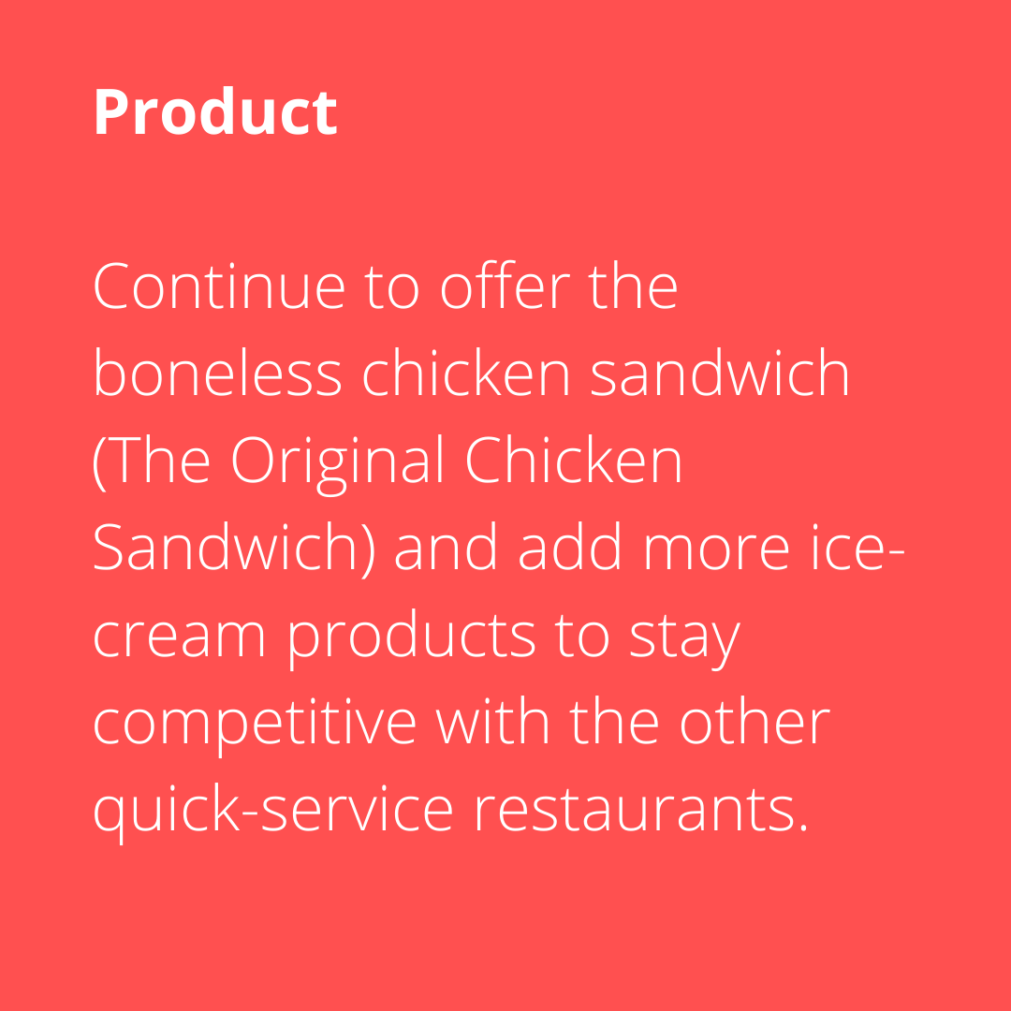
Overall 4P’s Managerial Implications & Recommendations

Slide 18
Overall PESTLE Managerial Implications & Recommendations
Political - By making use of the anti-corruption laws and the free trade agreements put forth by the Australian government, US based Chick-fil-A can start its expansion to Sydney before there is any change in such trade laws.
Economic - Advice Chick-Fil-A to analyze company turnover the first year to see if they will qualify for the lower tax bracket. This will aide in further projections regarding the income after taxes.
Social - Expanding into suburban regions where there are more family oriented customers and working class people.
Technology - Australian government is investing heavily in AI and drone technologies which could potentially be used for restaurants to benefit their business from. Digital innovation is lacking in Australia which could be a potential down but, Australia is known for quick incorporations of new tech.
Legal - Advice Chick-Fil-A to comply with all aspects of the Health, Safety and National employment laws to obey the Australian government.
Environmental: Advise to continue its sustainable restaurant construction and keep in mind of Australia’s bushfires and other natural issues that can occur.

Slide 19
Appendix
Executive Summary:
https://www.chick-fil-a.com
PESTEL:
Political -
Australian export and import laws - Austrade
Australia-United States FTA | Australian Government Department of Foreign Affairs and Trade (dfat.gov.au)
Economic -
https://economy.id.com.au/sydney/gross-product
https://pestleanalysis.com/pest-analysis-of-australia/
Social -
https://www.chick-fil-a.com/about/who-we-are
Technological -
https://www.startupdaily.net/2021/09/a-new-report-reveals-that-australia-is-falling-behind-the-us-uk-france-canada-and-china-on-digital-tech-innovation/

Slide 20
Appendix Continued
Environmental -
https://howandwhat.net/pestel-analysis-australia/
https://www.cityofsydney.nsw.gov.au/sustainable-sydney-2030
https://thechickenwire.chick-fil-a.com/inside-chick-fil-a/sustainable-design-changing-the-way-chick-fil-a-restaurants-are-built
Legal -
Work health and safety | business.gov.au
National Employment Standards | The Fair Work Act | Employsure Guides
Fair Work in Australia | Workplace Employment Law | Employsure
Hypothesis - https://www.farmonline.com.au/story/7316454/chicken-giving-lamb-and-beef-a-run-for-their-money/
Sydney, Australia
Five Countries That Consume The Most Chicken - Taste Inc
FACTS ABOUT SYDNEY • 84 Fun & Interesting Sydney Facts (jonesaroundtheworld.com)

